Slide 1

Mouse Genome Informatics Online Resource www.informatics.jax.org
Joanne Berghout, PhD
Oct 13, 2014

Slide 2
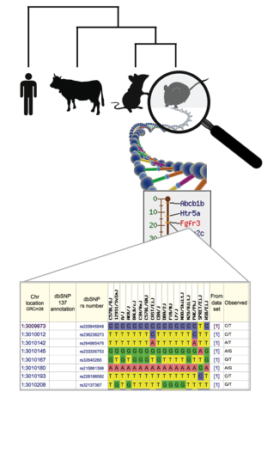
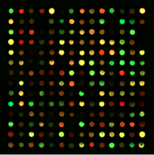
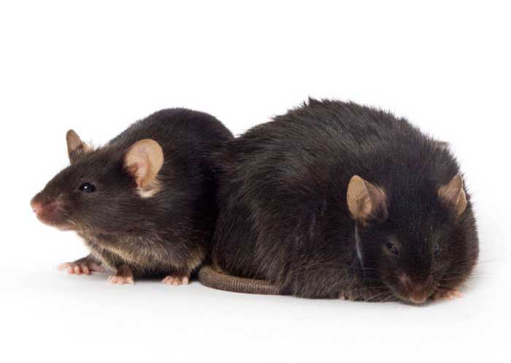
Genes, alleles and genotypes
Within a species, all members carry the same set of genes
Individual differences are due to allelic variation
“natural” background (eg. inbred line)
engineered variation (eg. knockout)
Differential gene expression patterns allow responsiveness and differentiation.
Phenotypes are annotated to genotypes, which is a description of the total allele combination of an individual

Slide 3
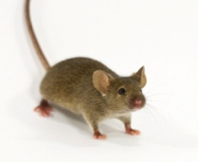
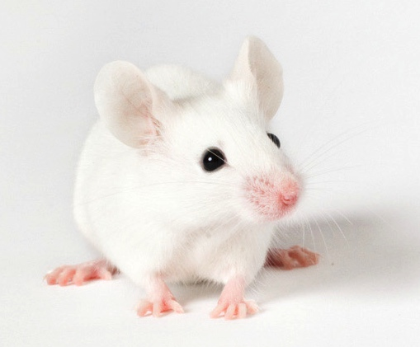
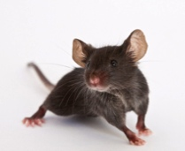
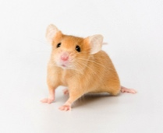
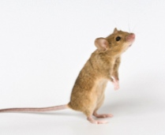
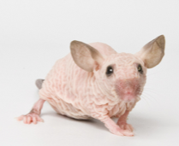
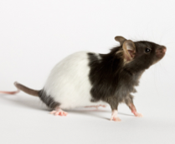
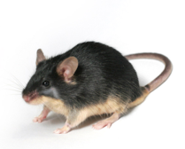
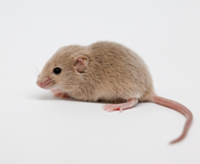
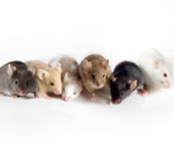
Inbred laboratory mouse strains
Laboratory mice are typically fully inbred
all animals are genetically identical within a strain
experimental consistency and reproducibility
differences between strains
comparing strains allows study of genetically influenced traits
Individual genes can also be studied using spontaneous mutations or targeted alleles
MGI currently lists over 39,000 mutant alleles that have been described in mice

Slide 4

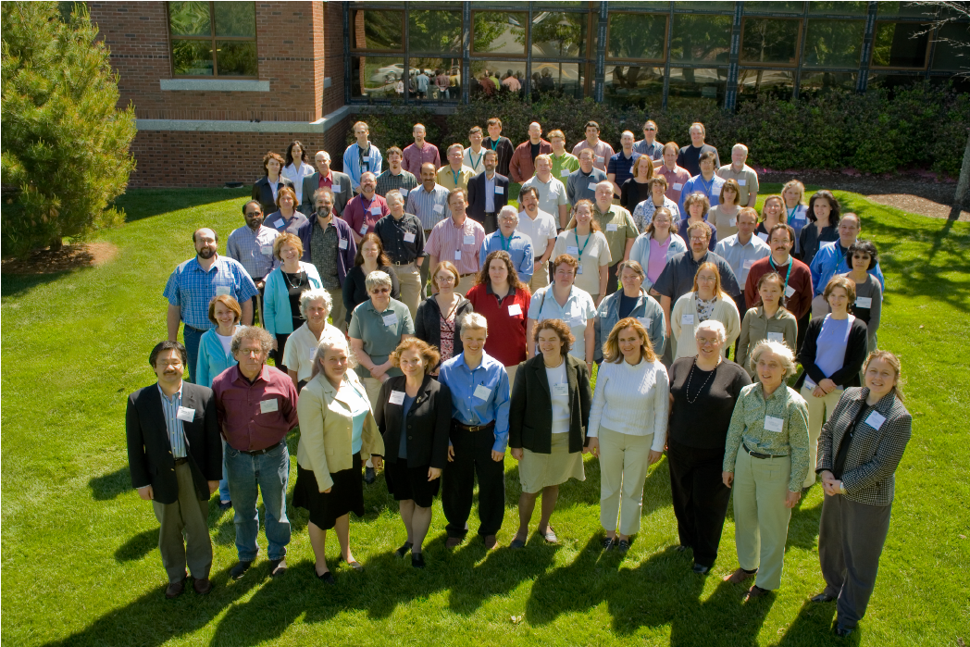
Mouse Genome Informatics
Online resource for genes, alleles, expression and phenotypes in the laboratory mouse
Notes:
One of the ways that

Slide 5

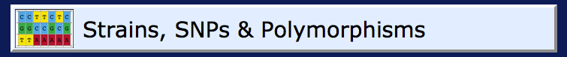




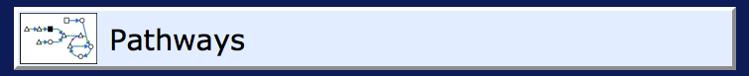

Phenotypes
Mutant Alleles
Data:

Slide 6
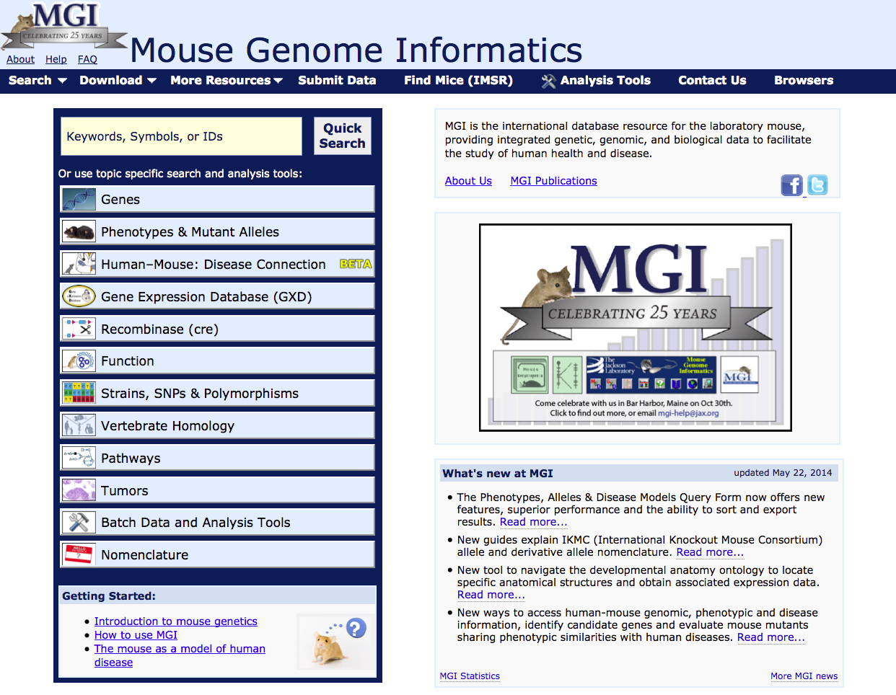

Slide 7




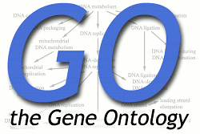



MGI data sources
Literature curation
Loaded* from large-scale projects or other databases
*may involve additional curation
Direct submission
Notes:
MGI is the comprehensive international database for genetic, genomic, expression and phenotypic data in the laboratory mouse. MGI was initiated along with several other model organism databases as part of the Human Genome Project in 1989 and has been supported by the NIH for 25 years now. The data in MGI come from a variety of data sources as depicted here: we have a staff of scientific curators who constantly comb through and read peer-reviewed publications, we accept direct submissions by researchers and we have a number of large data loads from other projects and sources which also feed in. Data is updated to the public site weekly.

Slide 8
Outline
Structured vocabularies, data structures in MGI
Gene and allele navigation
Computational and batch data access
Translational tools

Slide 9
Structured vocabularies
Standardized and searchable accession IDs
Allows linking of observations from diverse experimental designs, annotating similar findings under similar headings
Hierarchical relationships allow variable levels of precision
Notes:
Here is a screenshot of MGI’s Mouse Developmental Anatomy browser, and you can see that it is hierarchical, so if a researcher is very precise and describes a gene as expressed in the brain grey matter, it will also be pulled up if you are looking for all genes expressed in the brain, or in the central nervous system, or the nervous system and on up. We have a similar system for phenotypes, where observations are recorded on allele detail pages in a hierarchical way. If you can read it, there are three phenotypes listed under behavior/neurological with an additional level of detail on one of them. Below is an example of the Mammalian Phenotype Browser which you could also use for the reverse – instead of viewing which phenotypes have been annotated to your allele, you can find all the genotypes or genes that have this phenotypic annotation. While it may not be the most fascinating thing MGI has to offer, If any of you have an interest in computational biology or bioinformatics, understanding and having access to controlled, structured vocabularies will make your lives a whole lot easier.

Slide 10
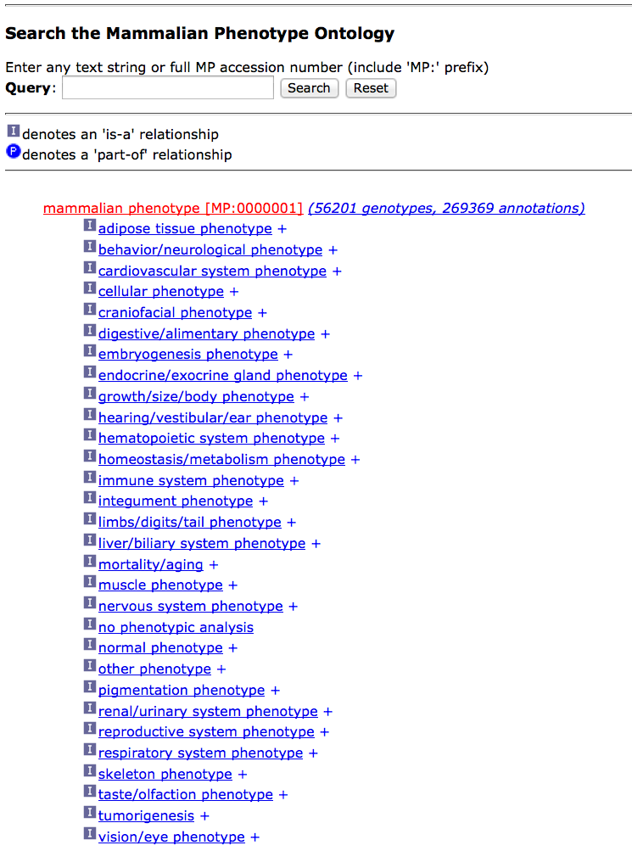
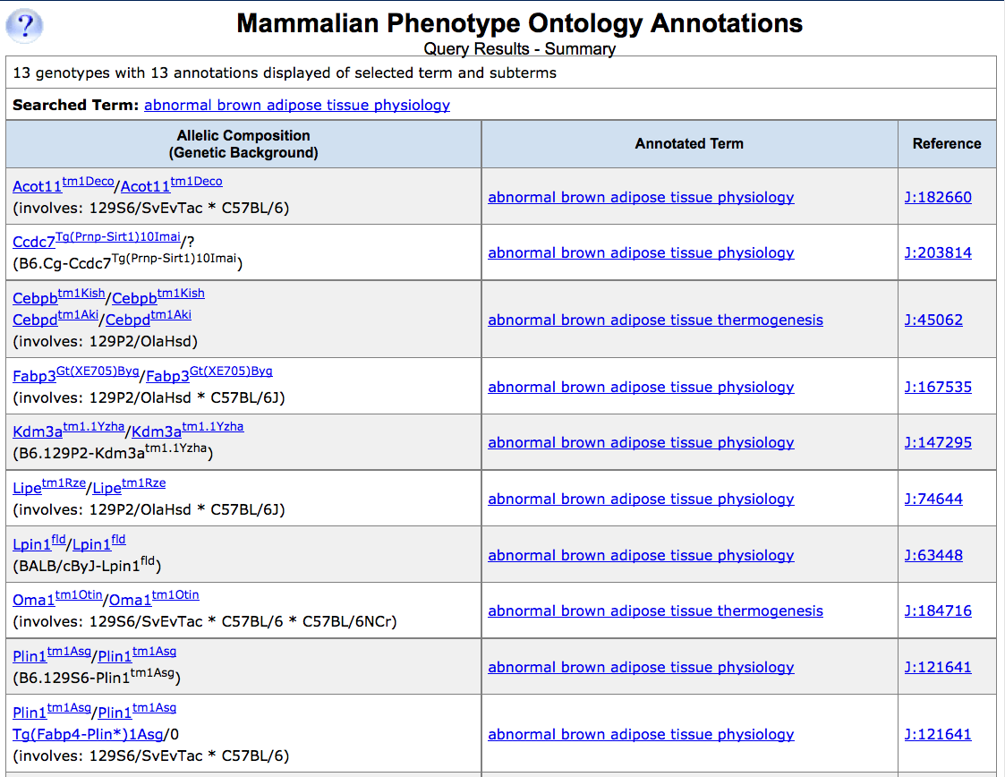
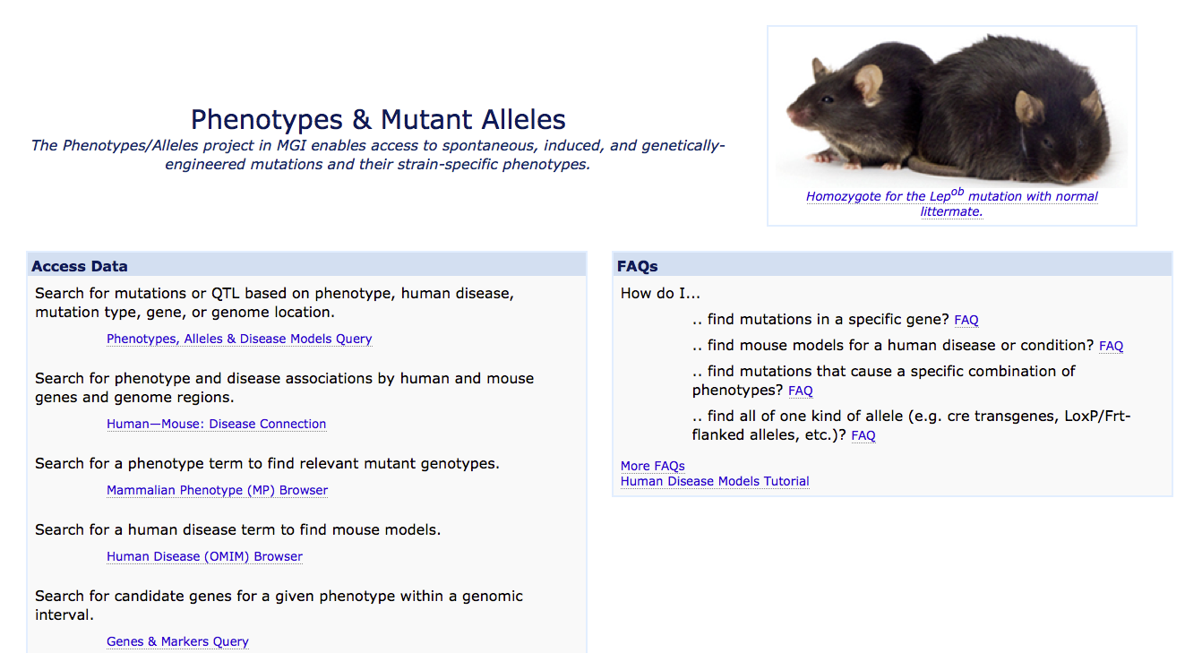
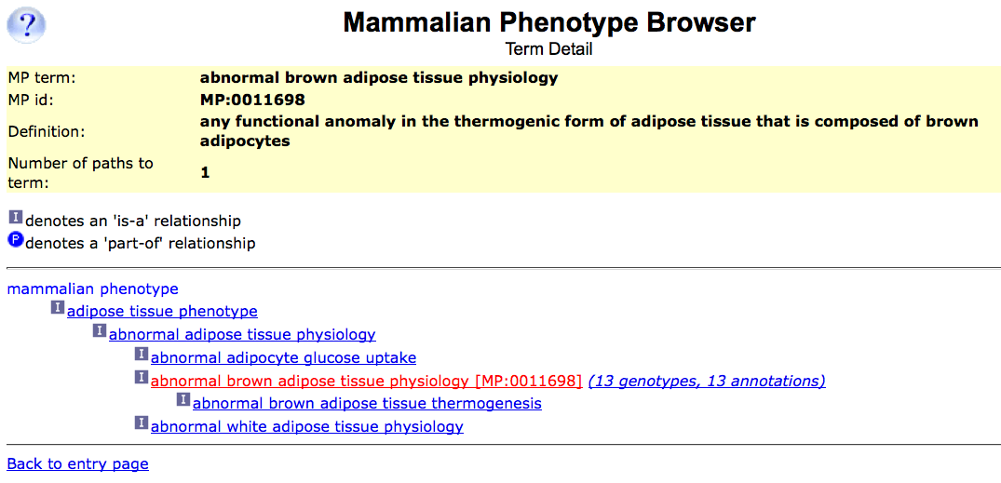
MGI’s structured vocabularies:
Mammalian Phenotype (MP) Browser

Slide 11
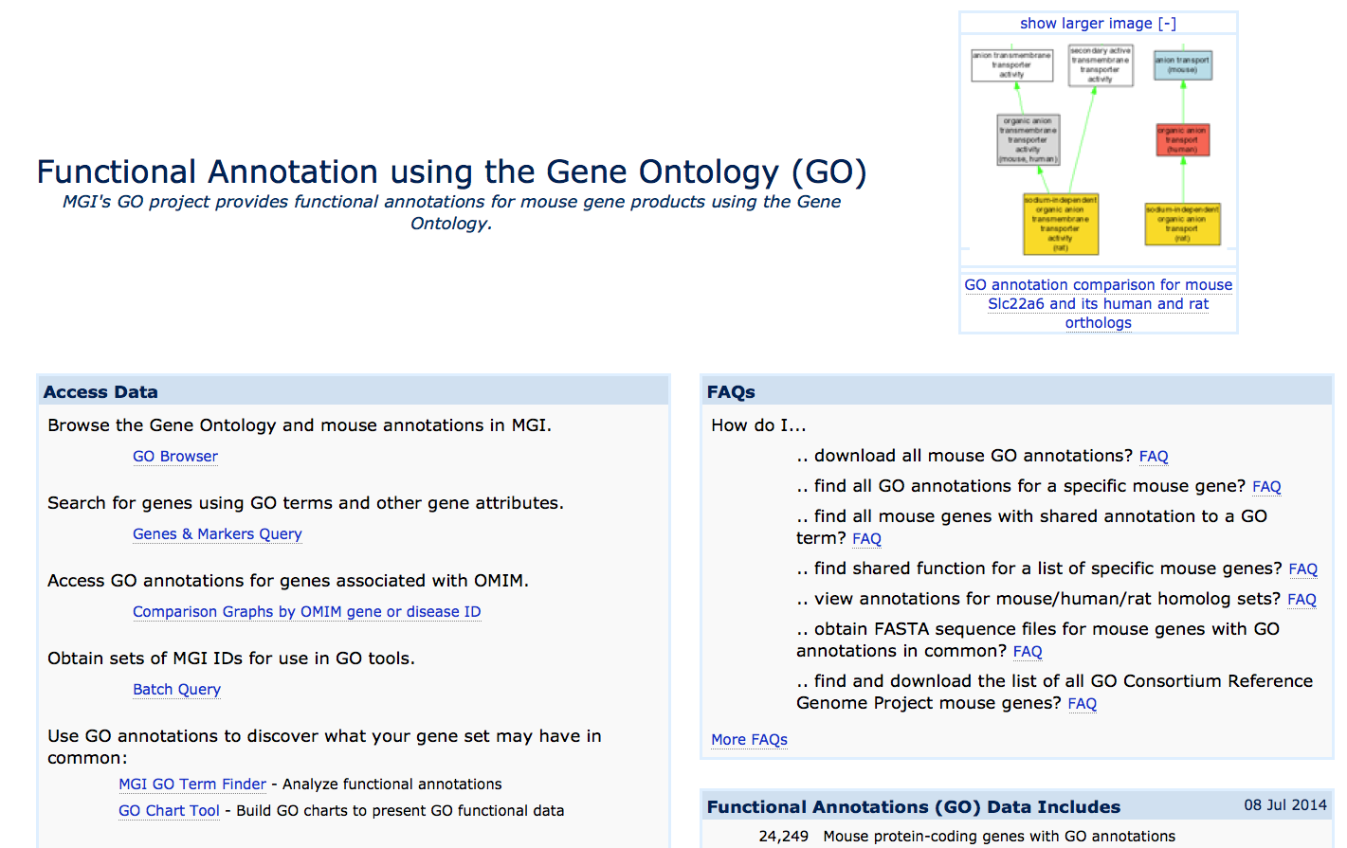
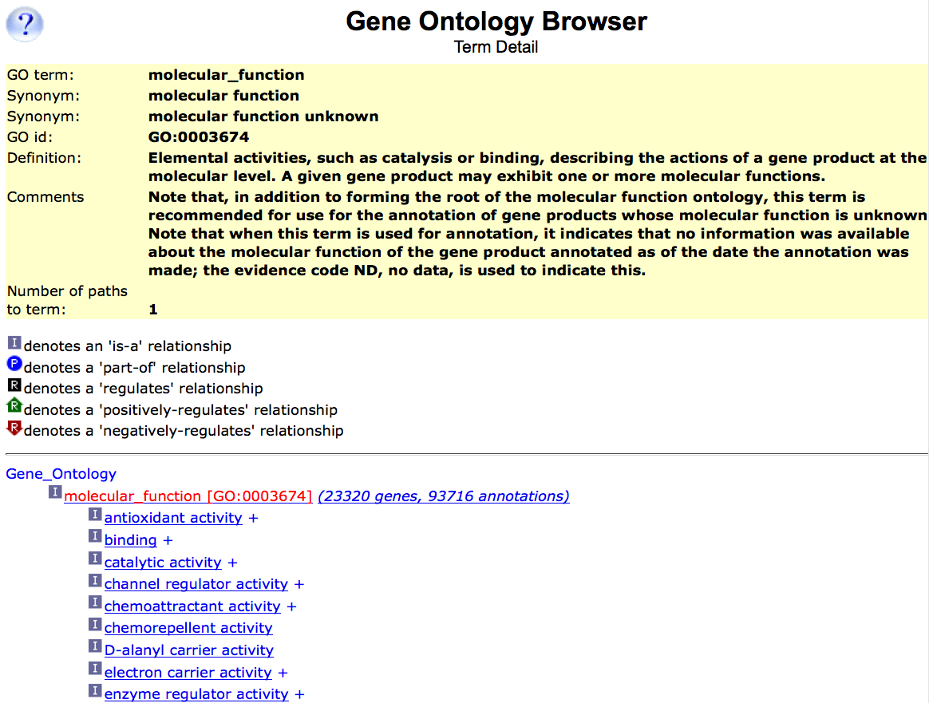
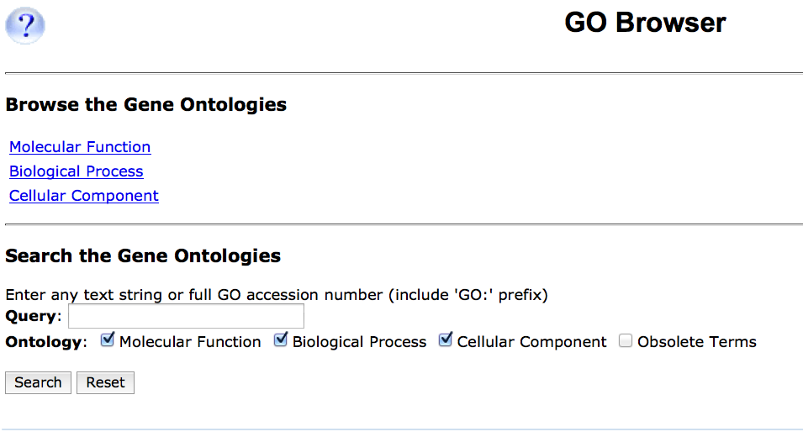
MGI’s structured vocabularies:
Gene Ontology (GO) Browser
Molecular Function
Biological Process
Cellular Component

Slide 12
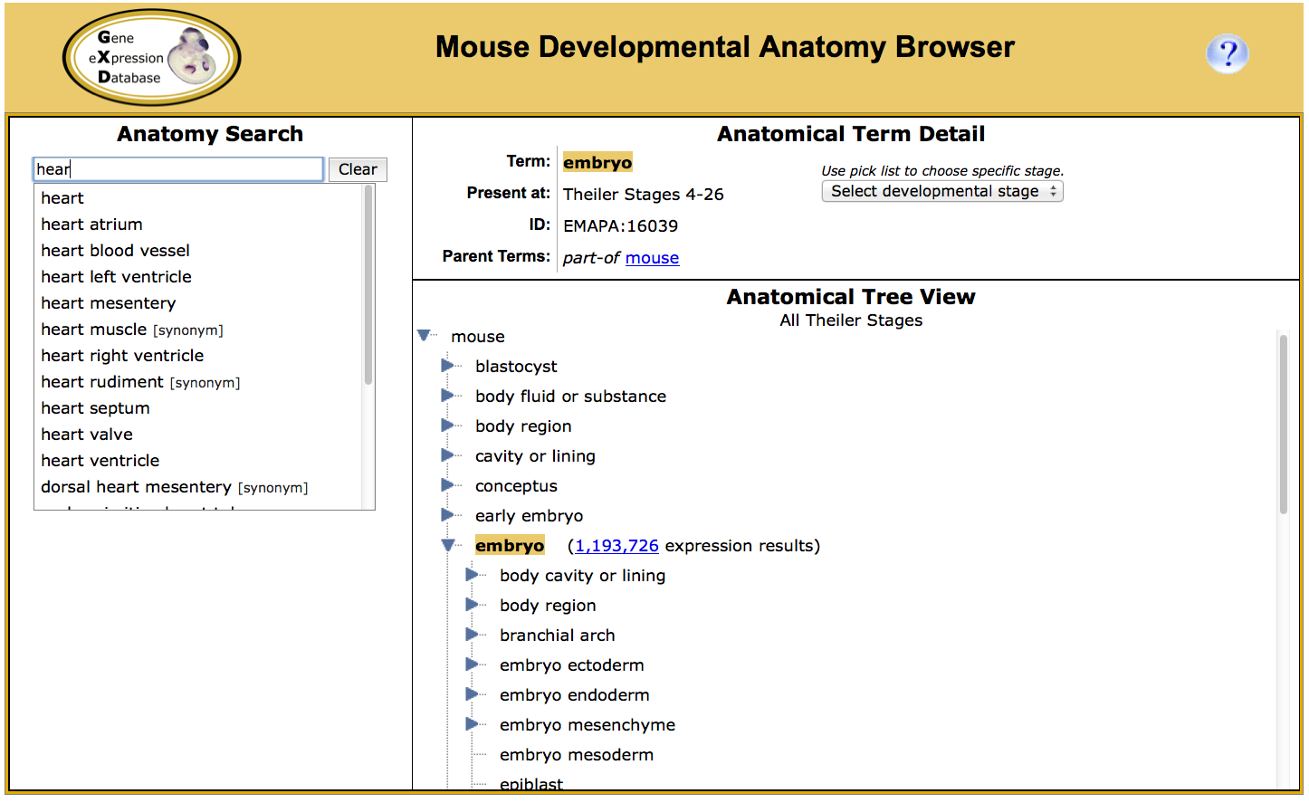
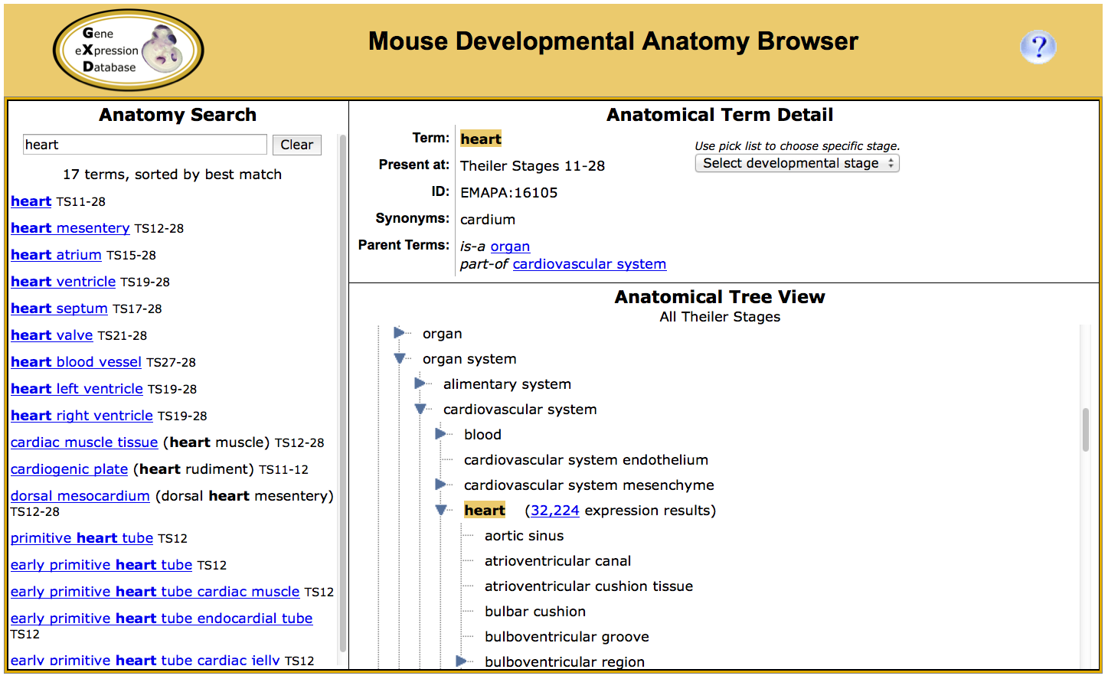
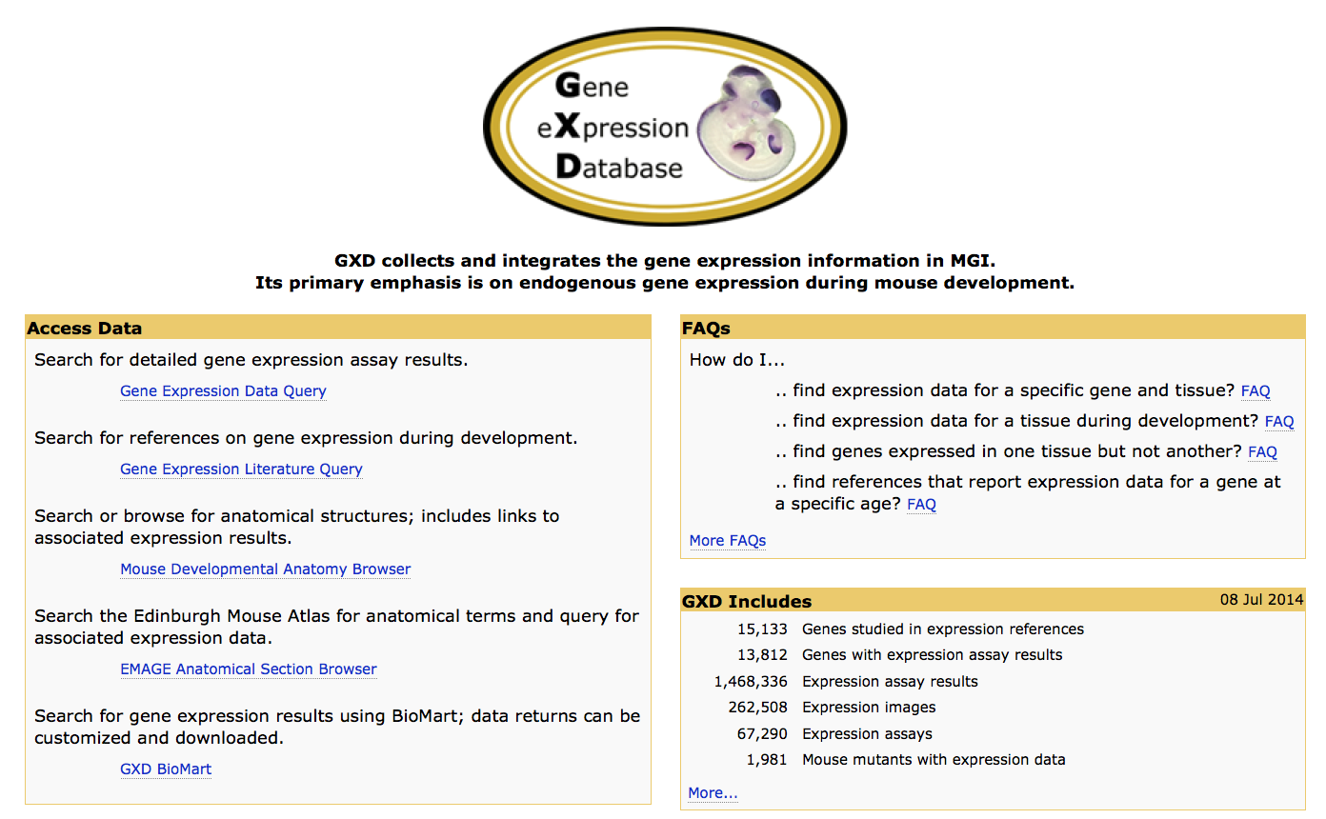
MGI’s structured vocabularies:
Mouse Developmental Anatomy Browser

Slide 13
Gene and allele navigation
Apoe

Slide 14
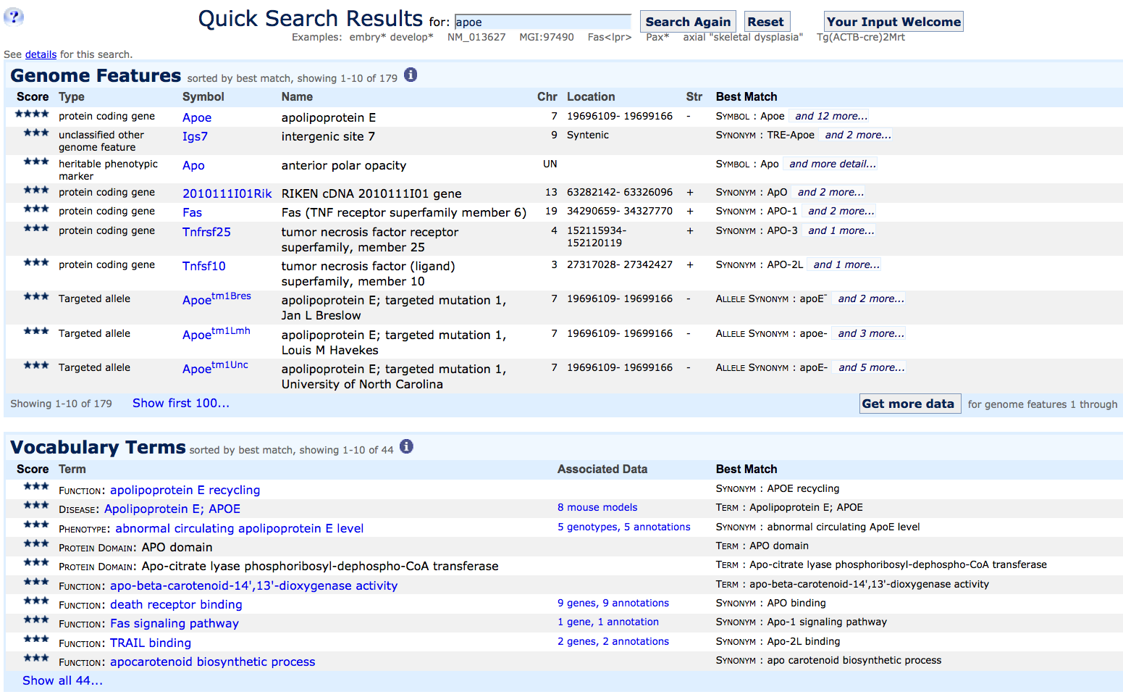
Quick search ranks results by best match
Notes:
The quick search will return a set of matches, ranked by best match and separated into a “Genome Features” and “Vocabulary terms” section. You can see here that our exact match: the protein coding gene Apoe is the top ranked hit and the far right column gives you an idea of why this particular feature was matched which may include synonyms, orthologs in other species or partial matching within a gene name. Below the Genome Features is the Vocabulary Terms, and here you see Functions, Diseases, Protein domains, and Phenotypes that all have some relevance to an apoe search. Click on Associated Data to see the genotypes, mouse models or other annotations.

Slide 15
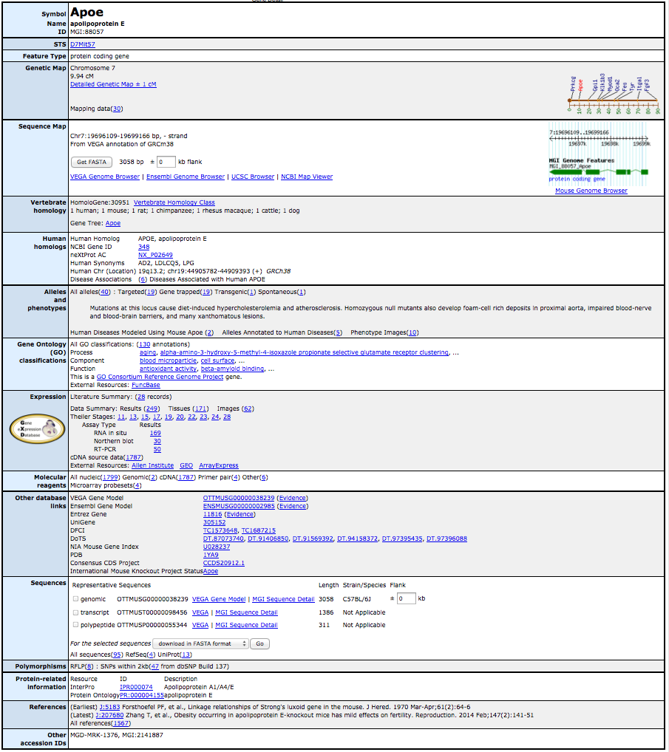
ID & synonyms
Position
Vertebrate homology
Phenotypes,
diseases & alleles
Function (GO)
Expression
Sequences & polymorphisms
Protein links
References

Slide 16
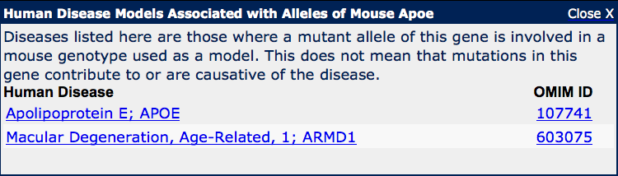
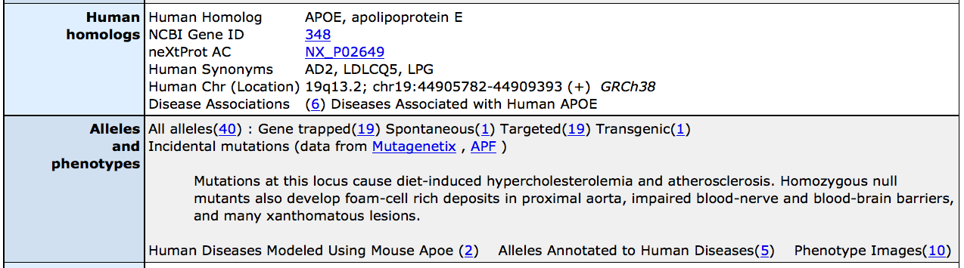
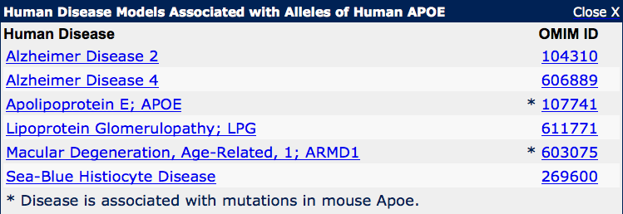
Alleles, phenotypes and associated diseases

Slide 17
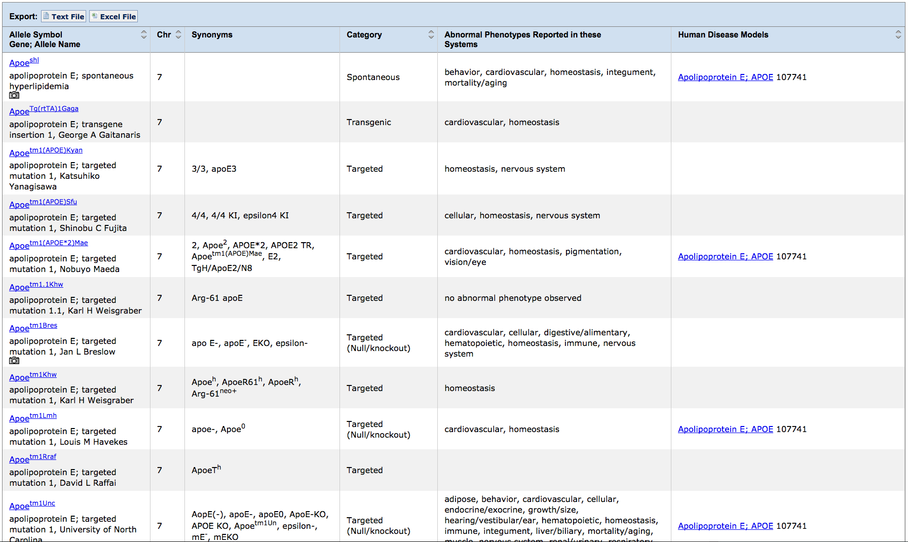
Phenotypic allele summary
Allele nomenclature:
(Gene Symbol)^{alleleID} : Apoe^{shl}
(Gene Symbol)^{tm(serial number)(lab code)} : Apoe^{tm1Bres}

Slide 18
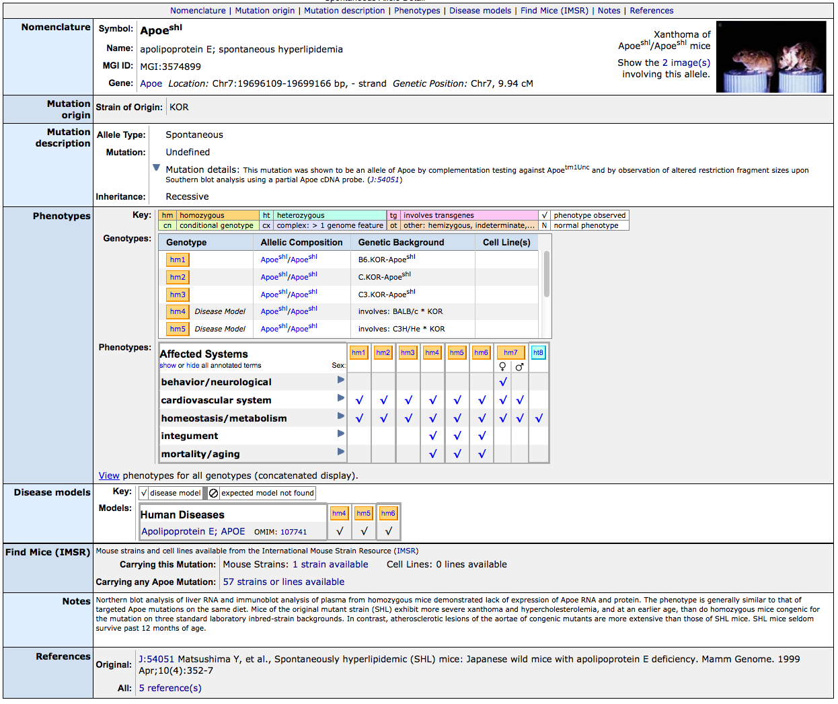

Slide 19
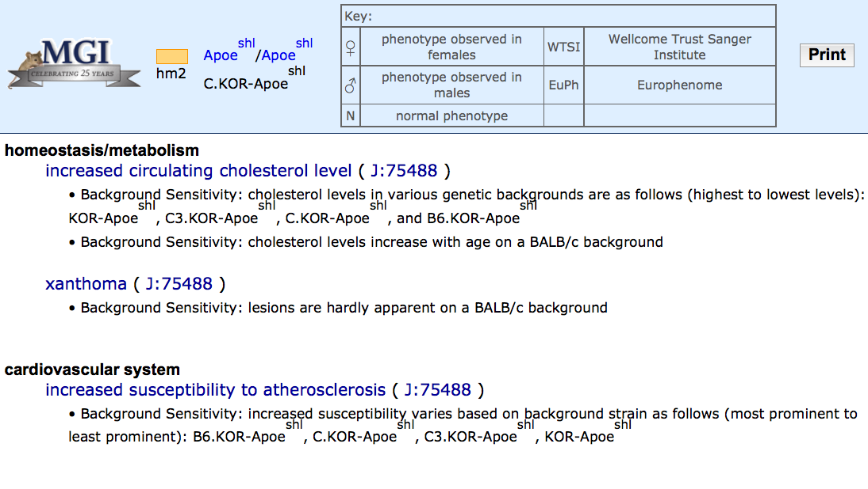
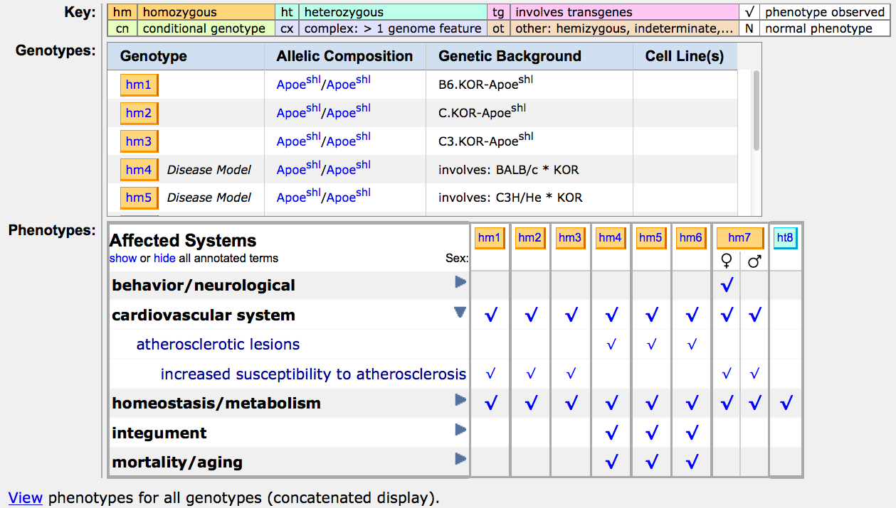
Phenotype tables annotate observations to genotypes

Slide 20
Genes and Alleles Section Summary
MGI provides data and tools for the research community in a relational database
Genes, alleles and phenotypes are described using searchable, structured terms as well as more detailed free text
each piece of information is cited with a J:# referring back to the source of the information

Slide 21
Outline
Structured vocabularies
Gene and Allele navigation
Computational access
Translational tools

Slide 22
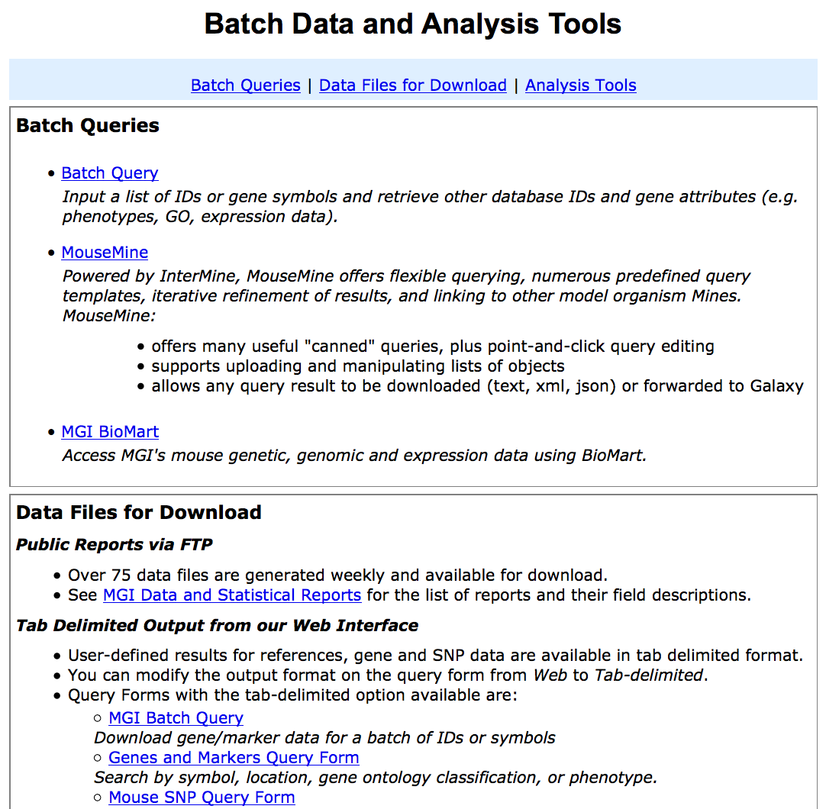
Computational access

Slide 23

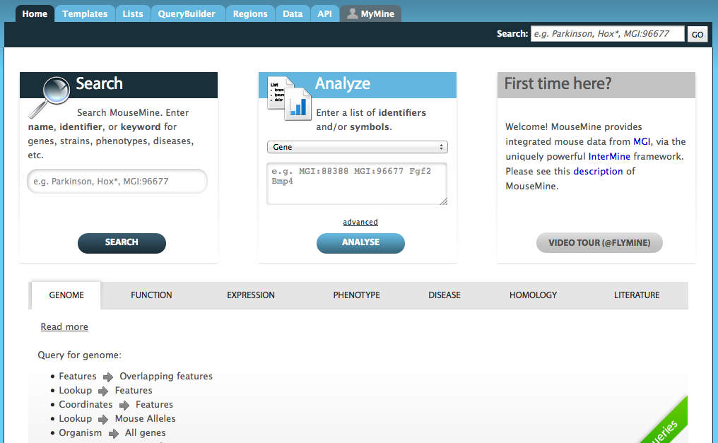

Slide 24
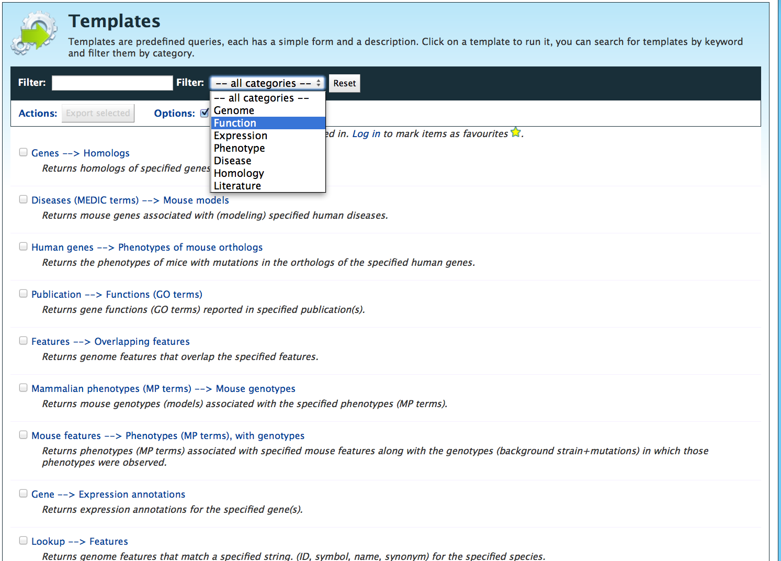
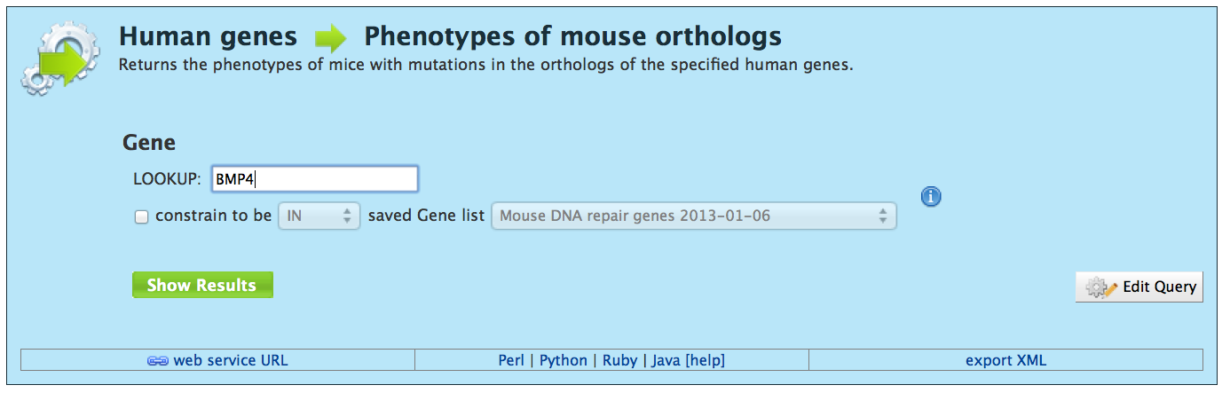
Pre-defined template queries:

Slide 25
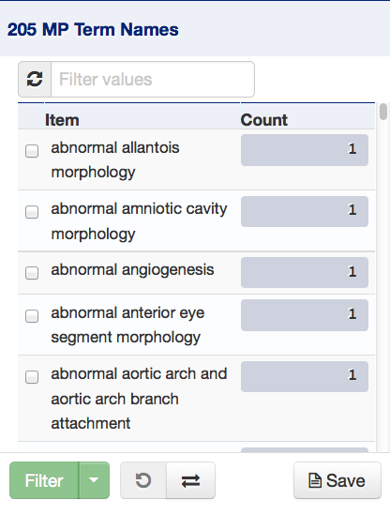
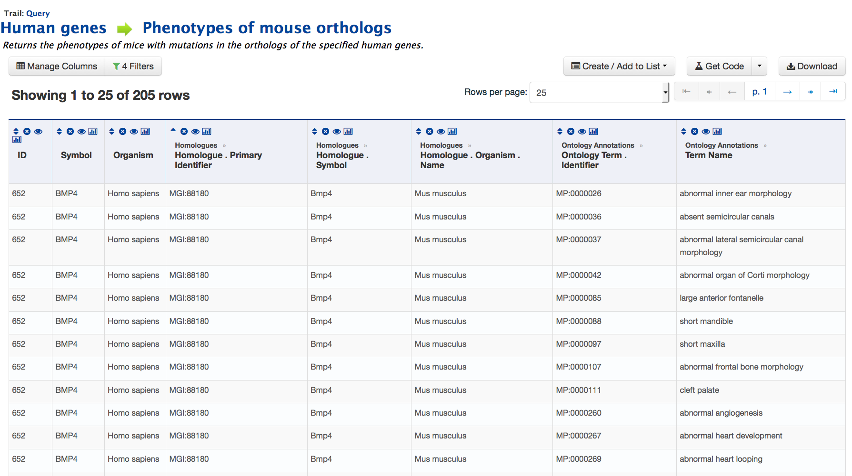
Results table: filterable, editable, downloadable

Slide 27
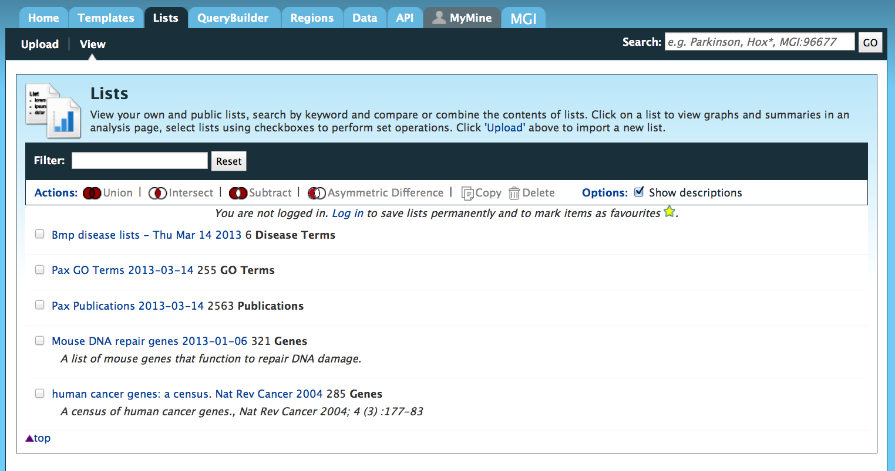
Lists pane: upload, view existing or perform actions (union, subtraction, etc)

Slide 28
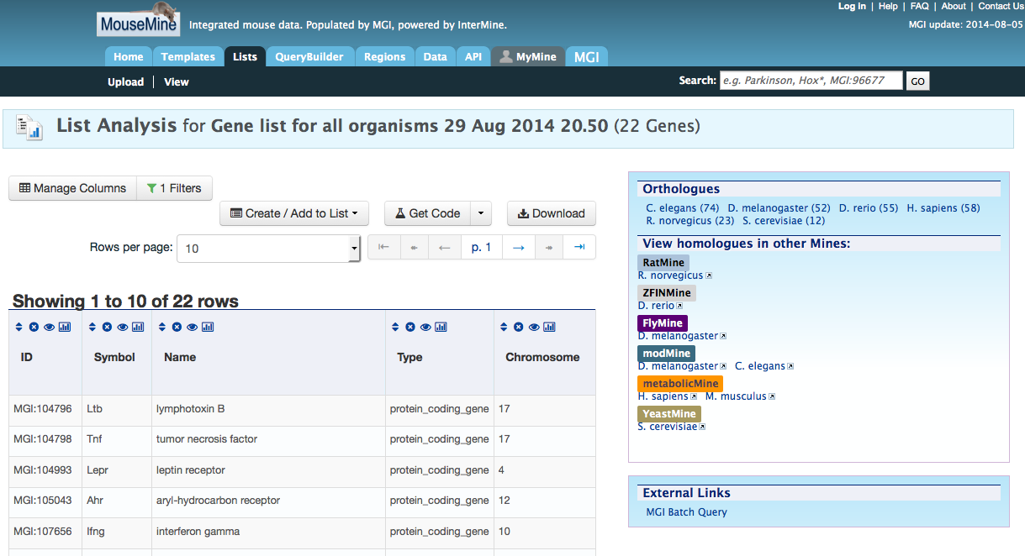
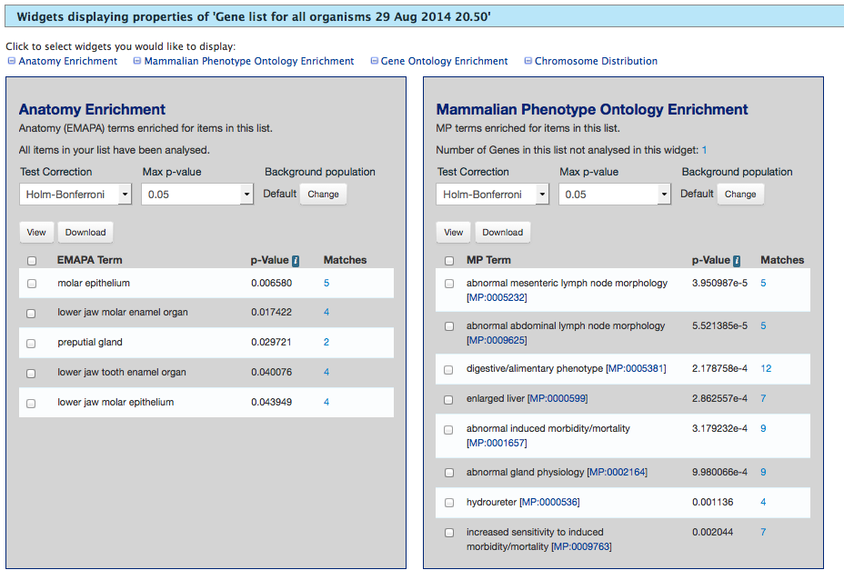
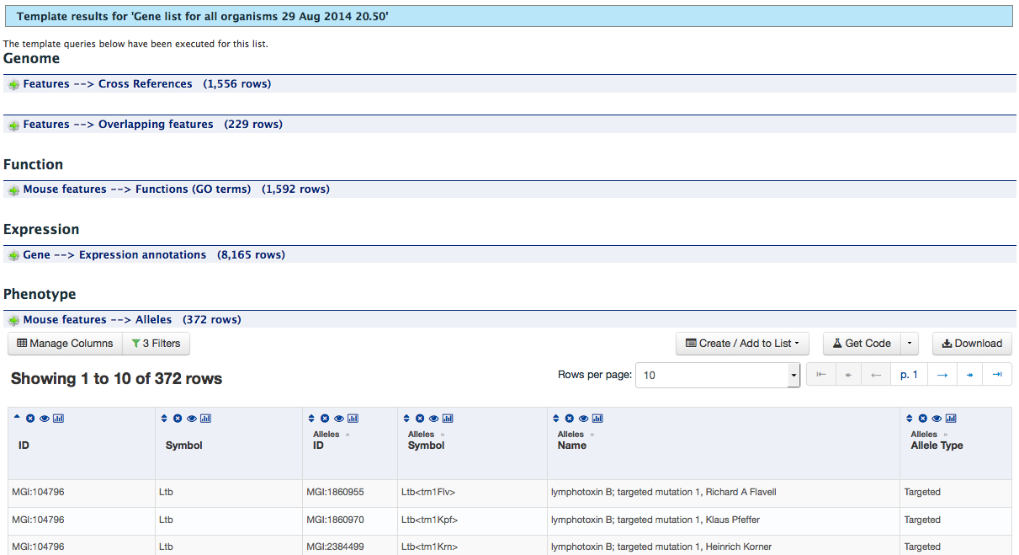
List
Add/remove columns
Sort and filter
Enrichment Widgets
Anatomy
Mammalian Phenotype
Gene Ontology
Chromosome
Templates
Run queries from list

Slide 29
Computational and Batch Data Section Summary
MGI generates daily and weekly tabular reports of data
MouseMine allows straightforward, flexible batch-scale querying of MGI data
MouseMine contains multiple useful list analysis tools
enrichment analysis
intersections with other MGI data

Slide 30
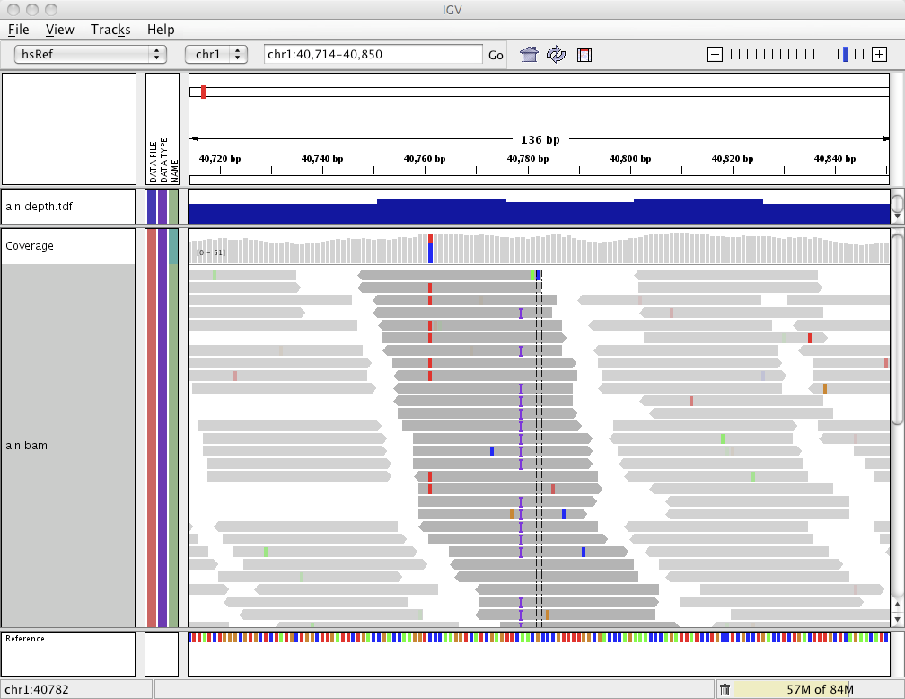

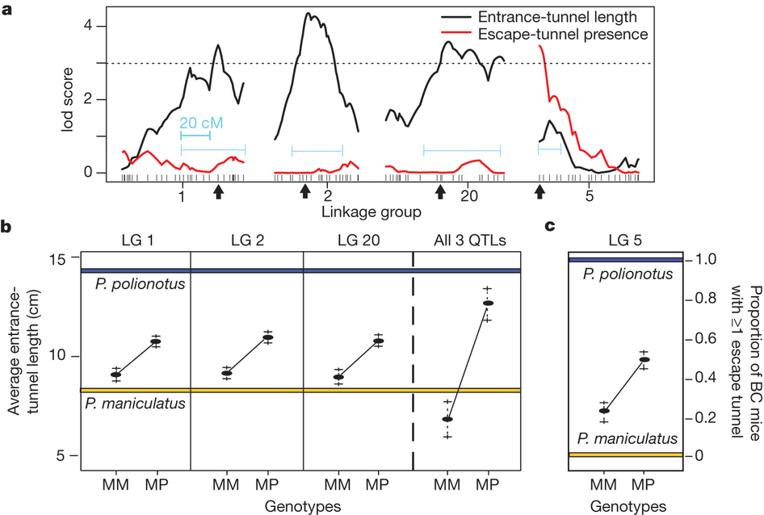
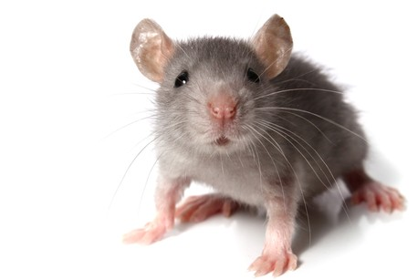


Clinical genetic research and translation
Notes:
This is the idea of either taking the results of research done in mice and translating those to humans, or begins with research originated in humans, where the mouse can be used as an experimental model. For this tool, you can begin with a gene list derived from an exome sequencing result within a specific mouse, patient or pedigree, a region defined by a GWAS or QTL association study, or an observed phenotype or disease.

Slide 31



Slide 32

Visual display of associated phenotype and disease results
Mammalian (mouse)
Phenotypes
Human disease (OMIM)
Notes:
This reveals a visual grid of associated phenotype and disease results. Each row corresponds to a gene, and then each column represents a phenotype or disease association. Coloured boxes at the intersection indicate that a particular gene has an annotation within that system. <click> On the left of the grid, in blue, you see mammalian phenotype systems which comes from mouse data and annotations. On the right, you see human diseases, where orange indicates that the gene has been associated from studies in human patients and loaded from OMIM, and blue indicates that a mutant mouse has been described as a model of the human disease. Bi-coloured boxes with both blue and orange indicate that mutations in this gene have been disease-associated in both species. I’ll also draw your attention to the additional “Genes” and “Diseases” tabs in behind, which we’ll look into later

Slide 33



Click to drill-down for more precise MP and allele IDs
Notes:
A very light coloured box, such as here at the intersection of Interleukin 20 and “cellular phenotype” may bring up a single annotation, where you can see the precise allele in which a cellular phenotype was reported, along with the more specific term of “osteoclast differentiation” Clicking on a dark coloured box, as seen at the intersection of Jak3 and “immune system”, reveals multiple Jak3 alleles and many more precise terms under the umbrella of immune system.

Slide 34



Click right side to view disease
Notes:
Similarly, on the right side of the grid, clicking the cells with data will reveal the details of gene-disease associations. Gap junction 9 is an example of a gene which has been associated to cataracts in both humans and mouse, and you can see that four different alleles in the mouse have all been used as cataract disease models.

Slide 35
Visual display of associated phenotype and disease results
Notes:
Along with exploring and drilling down into the data, it is possible to apply filters for both columns and rows which will hide any systems or genes that have no data in the selections. This will filter all tabs.

Slide 36
Translational tools Section Summary
The Human-Mouse: Disease Connection allows rapid accession and association of gene-phenotype or gene-disease information
Allows clinical researchers with human data to perform functional or phenotypic annotation to a gene list

Slide 37


Principle Investigators:
Judith A. Blake
Carol J. Bult
Janan T. Eppig (MGD)
James A. Kadin
Martin Ringwald (GXD)
Joel E. Richardson
Curatorial Staff:
Anna Anagnostiopoulos
Randal P. Babiuk
Dale A. Begley
Susan M. Bello
Nancy E. Butler
Karen Christie
Howard Dene
Harold J. Drabkin
Jacqueline H. Finger
Paul Hale
Terry F. Hayamizu
David P. Hill
Michelle Knowlton
Debra M. Krupke
MeiYee Law
Monica McAndrews
Ingeborg J. McCright
Li Ni
Hiroaki Onda
Wendy Pitman
Karen Rasmussen
Jill M. Recla
Deborah J. Reed
Beverly Richards-Smith
Dmitry Sitnikov
Constance M. Smith
Cynthia L. Smith
Monika Tomczuk
Linda L. Washburn
Jingxia Xu
Yunxia (Sophia) Zhu
Software Staff:
Richard M. Baldarelli
Jonathan S. Beal
Olin Blodgett
Jeffrey W. Campbell
Lori E. Corbani
Sharon C. Giannatto
Mary E. Dolan
Kim L. Forthofer
Peter Frost
Lucie Hutchins
Jill R. Lewis
Howie Motenko
David B. Meirs
Steven B. Neuhauser
Kevin R. Stone
Administrative and User Support:
Janice E. Ormsby
Joanne Berghout
David R. Shaw

